Slide 1
Data Visualization
Dr. Bui Thi Mai Anh
School of information and communication Technology
Hanoi University of science and technology
Notes:
I am responsible for introducing to you how to visualize data.
In this course, we will learn about analyzing data using visualization tools such as graph, chart, etc.
We also find out several types of data

Slide 2
Syllabus of the course
4 hours
Visualize multiple forms of 2D graphs
Customize graphs
Load data from files or from Internet sources for data visualization
Graphs and Networks Visualization
Notes:
So, the syllabus of the course: during 4 hours

Slide 3
Overview of Visualization
Mathematical Visualization
Scientific Visualization
Information Visualization

Slide 4
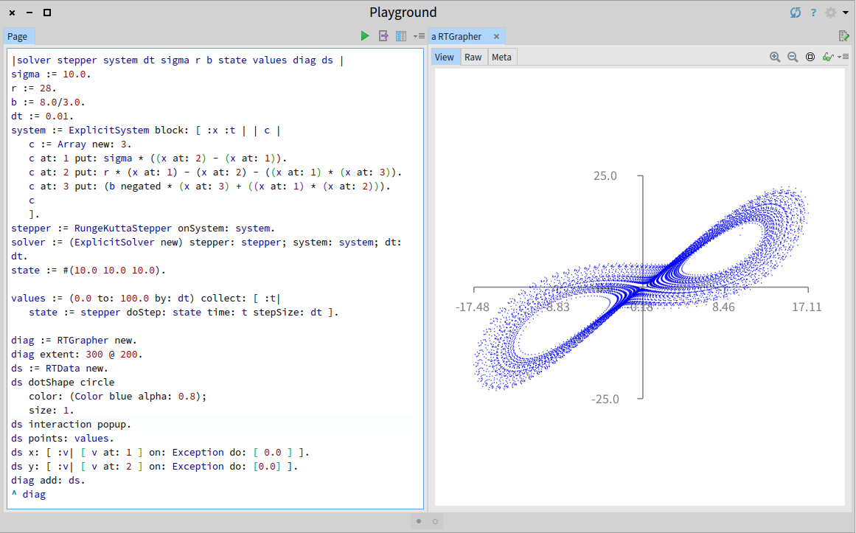
Mathematical Visualization
Data results from a mathematical equation
Missing data can be readily generated by a computer program
Notes:
What is mathematical visualization?
Have you ever tried Matlab or Scilab? A mathematical modelling language.
These languages are used to manipulate with maths: matrix, equations, differential equations etc.
So, mathematical visualization is for representing mathematical equations.
For example, our observation data formulates a mathematical equation, we can use computer program to generate full form of data

Slide 5
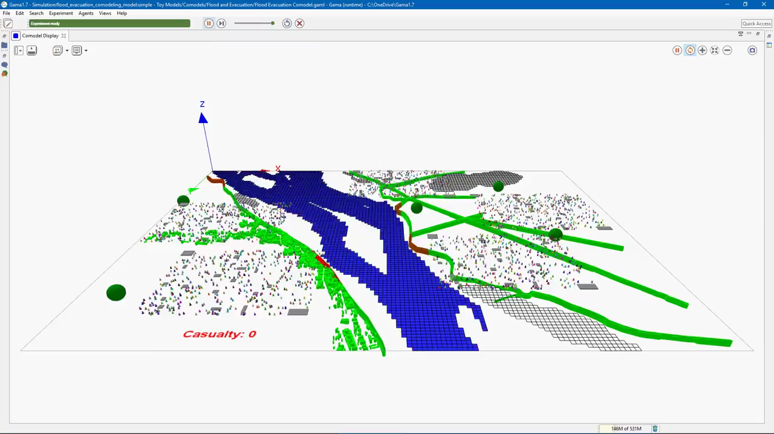
Scientific Visualization
Visualization of scientific data
Data measured from real world scientific devices or come from expensive simulations
Coordinate data
Spatial coordinates
Temperature, pressure
time
Notes:
Video: flood evacuation simulation

Slide 6
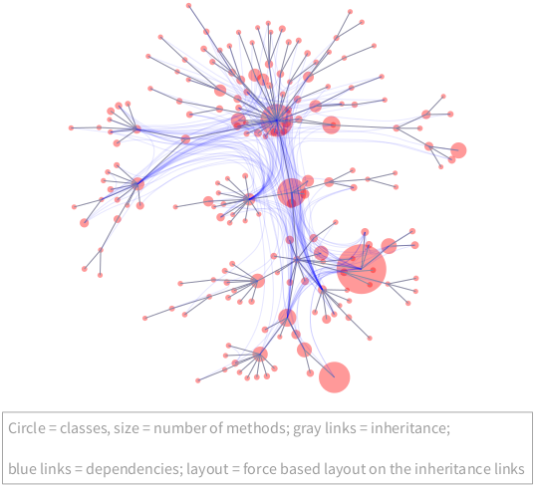
Information Visualization
Visualization of more abstract, non-coordinate data
Process abstract data into a more concrete form that can be more effectively perceived by an observer
Notes:
An example of visualization of the complexity of a software through its code. Each node is a class, a class can connect to another one (inheritances or dependencies)

Slide 7
Modes of Visualization
Interactive Visualization
Used for discovery
Presentation Visualization
Used for communication
Intended for large group or mass audience
Intended for a single investigator
Re-renders based on user input
Does not support user input
Notes:
Emphasis: Interact with data vs Just present data

Slide 8
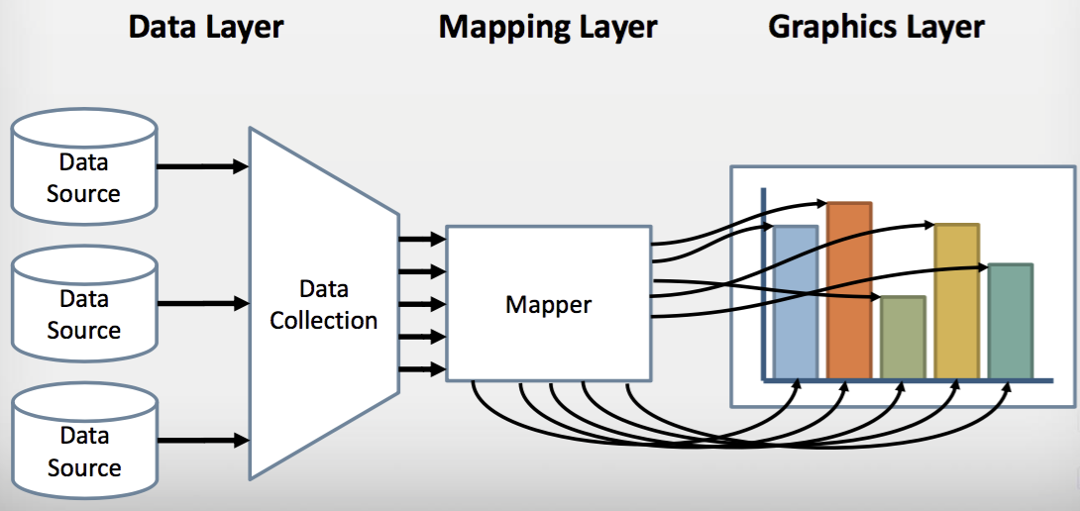
Data Visualization Framework
Notes:
This framework shows how data is processed for visualization. First, data is available to us from a variety of sources, so there is a data collection operation that combines data and processes it into one package for visualization. Then there is a mapping layer this mapper that takes data and converts it into some geometric representation, something very concrete then the Graphics Layer can take and display

Slide 9
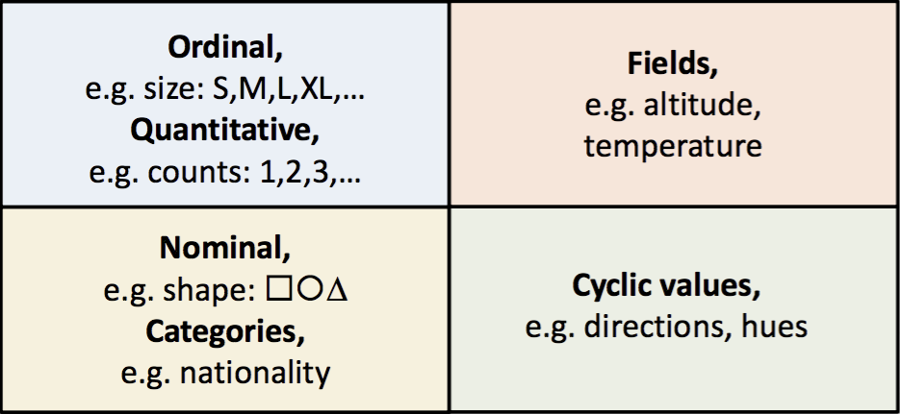
Data Types
Discrete
Continuous
Ordered
(values are comparable)
Unordered
(values are not comparable)
Notes:
Data can either be discrete or continuous, be comparable or not comparable. Take some examples:
Ordinal data: skirt size, S < M < L < XL
Quantitative data: numerical data
Continuous data: temperature, coordinates…
Unordered or not comparable discrete data: shape, nationality...
Cyclic values: degree of an angle from 0 – 360, but after 360 degree, you go back to 0 degree and so any one is not greater than any other, RGB values (continuous values for red, green, blue) but they are unordered.

Slide 10
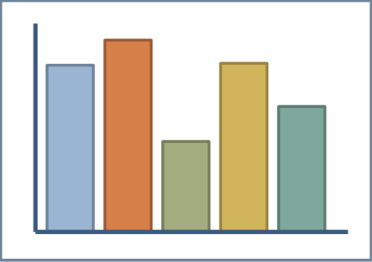
Column Charts
Benefits from both position (top of bar)
and length (size of bar)
Quantitative
Dependent
variable
Discrete/Nominal
Independent variable

Slide 11
Bar charts
Discrete/Nominal
Independent variable
Benefits from both position
and length
Quantitative
dependent variable

Slide 12
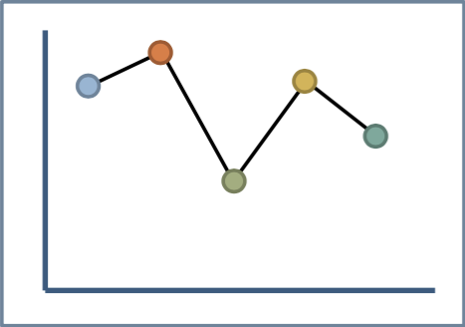
Line charts
Benefits from position but not length
Quantitative continuous
dependent
variable
Quantitative continuous
independent variable

Slide 13
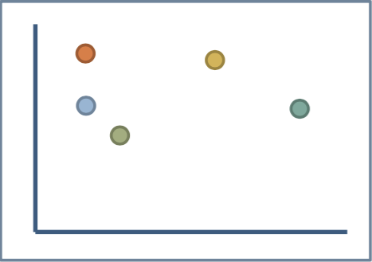
Scatter Plot
Relies mostly on position but clusters also yield density
Quantitative
independent
variable
Quantitative
independent variable

Slide 14
Matplotlib Architecture
Backend Layer
To render the plots to screen or files
Artist Layer
Contains containers such as Figure, Subplot and Axes
Contains primitives such as a Line2D, Rectangle, collections etc.
Scripting Layer
Simplifies access to the Artist and Backend layers

Slide 15
Matplotlib Architecture
Backend Layer
Deals with actual drawing
Artist Layer
Describes how data is arranged
Script Layer
Creates artists, compose them all together
Procedural methods for building visualization
Notes:
There are also declarative methods to build visualization, HTML, google chart JS, etc. is a great example of this kind.
Instead of issuing command after command to the backend rendering agent as procedural methods, declarative methods often format a document as a model of relationship (often called DOM or Document Object Model)

Slide 16
Basic Plotting with matplotlib
Requirements: Python, Matplotlib for data visualization and numpy (array supports for Python)
Before plotting, import pyplot functionality (for plotting) and numpy functionality (for mathematics and for working with arrays)
Or, just import pylab: a combination of pyplot and numpy
import numpy as np import matplotlib.pyplot as plt
from pylab import *

Slide 17
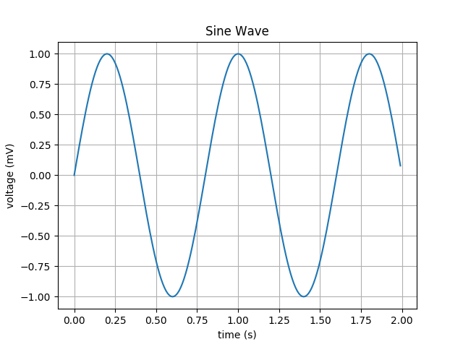
Line chart (pylab vs pyplot)
from pylab import * t = arange(0.0, 2.0, 0.01) s = sin(2.5*pi*t) plot(t,s) xlabel('time (s)') ylabel('voltage (mV)') title('Sine Wave') grid(True) show()
import numpy as np import matplotlib.pyplot as plt t = np.arange(0.0, 2.0, 0.01) s = np.sin(2.5*np.pi*t) plt.plot(t,s) plt.xlabel('time (s)') plt.ylabel('voltage (mV)') plt.title('Sine Wave') plt.grid(True) plt.show()
Python 2.7.10, Editor: Pycharm Community Edition V.2017.1.4, Matplotlib V.2.0.2
Notes:
A line plot is created with the plot function

Slide 18
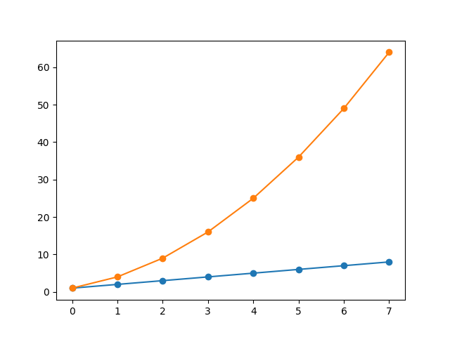
Line chart (cont.)
import numpy as np import matplotlib.pyplot as plt linear_data = np.array([1,2,3,4,5,6,7,8]) exponential_data = linear_data**2 plt.plot(linear_data, '-o', exponential_data, '-o') plt.show()
Notes:
Note that the plot function may take several series together, we can just give y-axes values, no x-axes values, in which case the function will use the index of the series as the x values

Slide 19
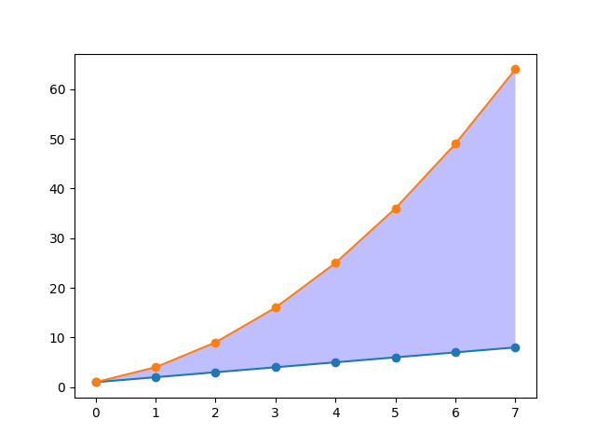
Line chart (cont.)
import numpy as np import matplotlib.pyplot as plt linear_data = np.array([1,2,3,4,5,6,7,8]) exponential_data = linear_data**2 plt.plot(linear_data, '-o', exponential_data, '-o')
plt.gca().fill_between(range(len(linear_data)), linear_data, exponential_data, facecolor='blue', alpha=0.25) plt.show()
Notes:
We may use the fill_between function to highlight the difference between the blue and the orange curves.
First, we get the current axes object, then we indicate the range of x values we want to be filled, then we put in the lower bounds and upper bound along with the color we want

Slide 20
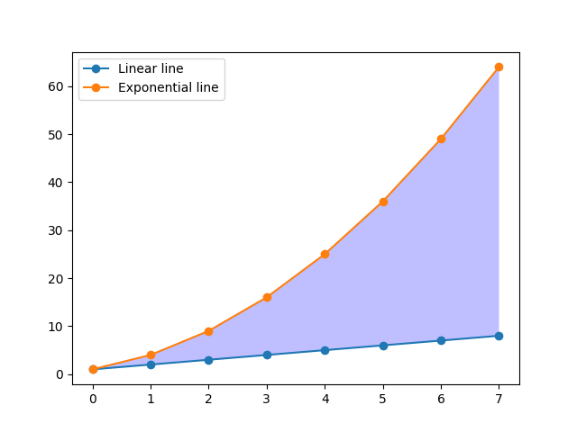
Line chart (cont.)
import numpy as np import matplotlib.pyplot as plt linear_data = np.array([1,2,3,4,5,6,7,8]) exponential_data = linear_data**2 plt.plot(linear_data, '-o', exponential_data, '-o')
plt.gca().fill_between(range(len(linear_data)), linear_data, exponential_data, facecolor='blue', alpha=0.25)
plt.legend(['Linear line', 'Exponential line']) plt.show()
Notes:
We may use the fill_between function to highlight the difference between the blue and the orange curves.
First, we get the current axes object, then we indicate the range of x values we want to be filled, then we put in the lower bounds and upper bound along with the color we want
Add legend for the plotting is very simple

Slide 21
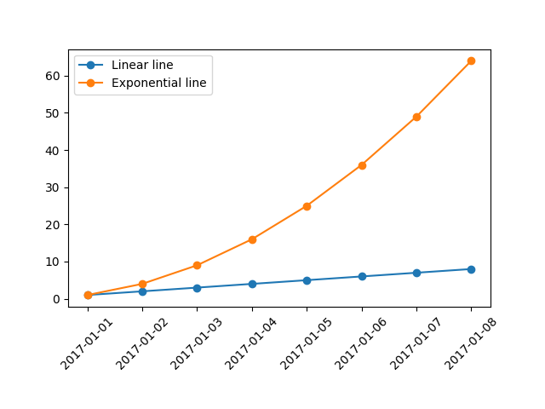
Line chart (cont.)
import numpy as np import matplotlib.pyplot as plt import pandas as pd linear_data = np.array([1, 2, 3, 4, 5, 6, 7, 8]) exponential_data = linear_data ** 2 observation_dates = np.arange('2017-01-01', '2017-01-09', dtype='datetime64[D]') observation_dates = list(map(pd.to_datetime, observation_dates)) plt.plot(observation_dates, linear_data, '-o', observation_dates, exponential_data, '-o') plt.legend(['Linear line', 'Exponential line']) x = plt.gca().xaxis # rotate the tick labels for the x axis for item in x.get_ticklabels(): item.set_rotation(45) # adjust the subplot so the text doesn't run off the image plt.subplots_adjust(bottom=0.25) plt.show()
Notes:
Customizing x-axis
Change the x-axis to a series of eight date time instance (with one day interval)
But NumPy does not support date time handling, so we use another module, pandas (to install pandas: just use the following command Terminal: pip install pandas

Slide 22
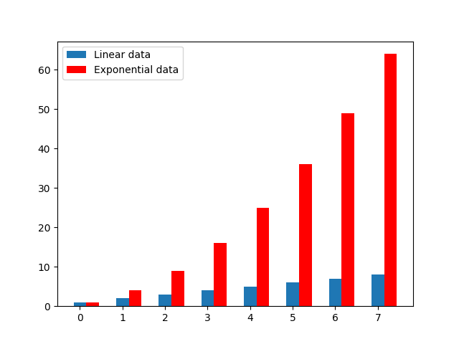
Bar Charts
import numpy as np import matplotlib.pyplot as plt linear_data = np.array([1, 2, 3, 4, 5, 6, 7, 8]) exponential_data = linear_data ** 2 xvals = range(len(linear_data)) plt.bar(xvals, linear_data, width=0.3) exp_xvals = [] for item in xvals: exp_xvals.append(item+0.3) plt.bar(exp_xvals, exponential_data, width=0.3, color='r') plt.legend(['Linear data', 'Exponential data']) plt.show()
Notes:
Matplotlib supports several kinds of bar charts
In general case, we plot a bar chart by sending in a parameter of x components and a parameter of the height of bars.
➔ It is very simple to group bars, but the x-values are not centered for each group ➔ using axis container to customize axis

Slide 23

Bar Charts (cont.)
import numpy as np import matplotlib.pyplot as plt linear_data = np.array([1, 2, 3, 4, 5, 6, 7, 8]) exponential_data = linear_data ** 2 xvals = np.arange(len(linear_data)) exp_xvals = [] for item in xvals: exp_xvals.append(item+0.3) fig, ax = plt.subplots() ax.bar(xvals, linear_data, width=0.3) ax.bar(exp_xvals, exponential_data, width=0.3, color='r') ax.legend(['Linear data', 'Exponential data']) ax.set_xticks(xvals + 0.3 / 2) ax.set_xticklabels(xvals) plt.show()

Slide 24
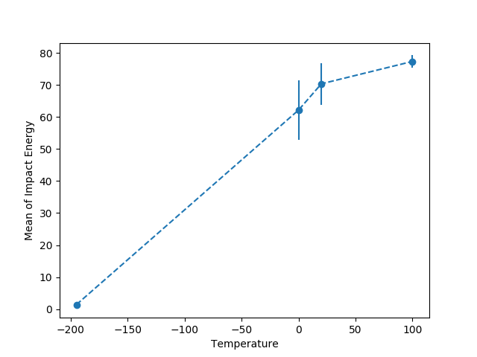
Using Error Bar with Line/Bar Charts
 | Temperature
 | -195 | 0 | 20 | 100
Impact Energy | 1 | 52 | 48 | 74
 | 1 | 58 | 66 | 82
 | 2 | 82 | 74 | 72
 | 1 | 35 | 86 | 80
 | 2 | 84 | 78 | 79
Mean | 1.4 | 62.2 | 70.4 | 77.4
Standard Deviation | 0.5 | 20.8 | 14.4 | 4.2
Standard Error | 0.2 | 9.3 | 6.5 | 1.9
import numpy as np import matplotlib.pyplot as plt temperatures = np.array([-195, 0, 20, 100]) mean_impact = np.array([1.4, 62.2, 70.4, 77.4]) std_error = np.array([0.2, 9.3, 6.5, 1.9]) fig, ax = plt.subplots() ax.errorbar(temperatures, mean_impact, yerr=std_error, fmt='--o') ax.set_xlabel('Temperature') ax.set_ylabel('Mean of Impact Energy') plt.show()
Notes:
Error bar for representing: CI (confidence intervals) for common P-values; SE (standard error) for mean values etc.

Slide 25
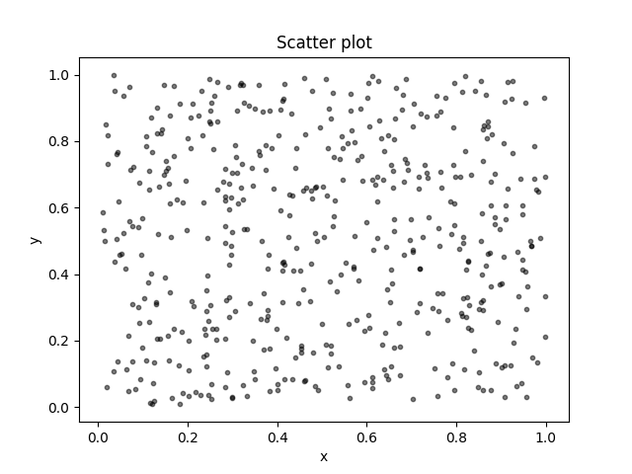
Scatter Plot
import numpy as np import matplotlib.pyplot as plt # Create data N = 500 x = np.random.rand(N) y = np.random.rand(N) colors = (0, 0, 0) area = np.pi * 3 # Plot plt.scatter(x, y, s=area, c=colors, alpha=0.5) plt.title('Scatter plot') plt.xlabel('x') plt.ylabel('y') plt.show()
Notes:
Using the function scatter, this function takes an x-axis value as the first parameter and y-axis value as the second, if the two parameters are the same we get a nice diagonal alignment of points

Slide 26
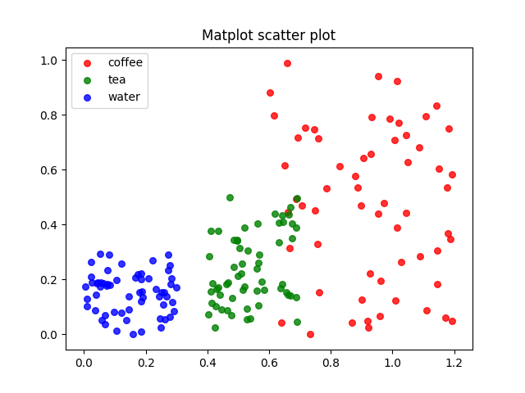
Scatter Plot
import numpy as np import matplotlib.pyplot as plt # Create data N = 60 g1 = (0.6 + 0.6 * np.random.rand(N), np.random.rand(N)) g2 = (0.4 + 0.3 * np.random.rand(N), 0.5 * np.random.rand(N)) g3 = (0.3 * np.random.rand(N), 0.3 * np.random.rand(N)) data = (g1, g2, g3) colors = ("red", "green", "blue") groups = ("coffee", "tea", "water") # Create plot for data, color, group in zip(data, colors, groups): x, y = data plt.scatter(x, y, alpha=0.8, c=color, s=30, label=group) plt.title('Matplot scatter plot') plt.legend() plt.show()
Notes:
Plotting different groups

Slide 27
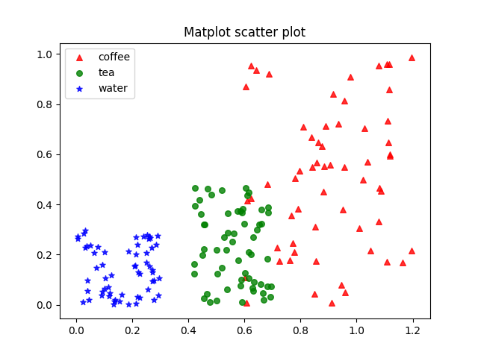
Scatter Plot
import numpy as np import matplotlib.pyplot as plt # Create data N = 60 g1 = (0.6 + 0.6 * np.random.rand(N), np.random.rand(N)) g2 = (0.4 + 0.3 * np.random.rand(N), 0.5 * np.random.rand(N)) g3 = (0.3 * np.random.rand(N), 0.3 * np.random.rand(N)) data = (g1, g2, g3) colors = ("red", "green", "blue") markers = ('^', 'o', '*') groups = ("coffee", "tea", "water") # Create plot for data, color, group, marker in zip(data, colors, groups, markers): x, y = data plt.scatter(x, y, alpha=0.8, c=color, s=30, label=group, marker=marker) plt.title('Matplot scatter plot') plt.legend() plt.show()
Notes:
Customizing symbols

Slide 28
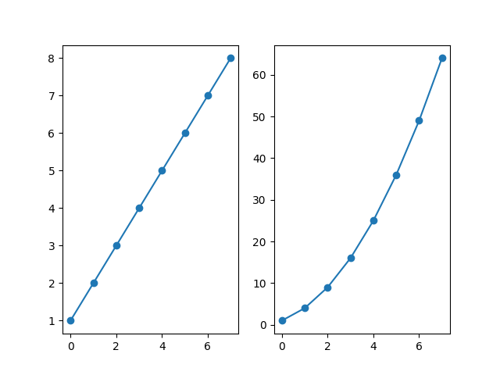
Subplots
import numpy as np import matplotlib.pyplot as plt linear_data = np.array([1,2,3,4,5,6,7,8]) exponential_data = linear_data**2 plt.subplot(1,2,1) plt.plot(linear_data, '-o') plt.subplot(1,2,2) plt.plot(exponential_data, '-o')
plt.show()
Notes:
Using the function subplots with parameters: the number of rows, number of column and the plot number. The greatest number alternatively from left to right and from top to bottom.
For example subplot(1,2,1)==> create two plots side by side, with one row and two columns and set the first axis to be the current axis (the left hand side axis)

Slide 29
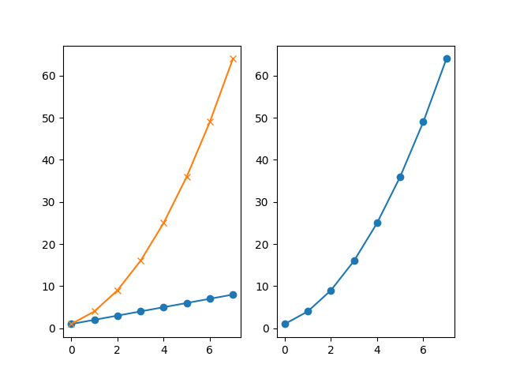
Subplots
import numpy as np import matplotlib.pyplot as plt linear_data = np.array([1,2,3,4,5,6,7,8]) exponential_data = linear_data**2 plt.subplot(1,2,1) plt.plot(linear_data, '-o') plt.subplot(1,2,2) plt.plot(exponential_data, '-o') #call subplot again to return to the plot number you want plt.subplot(1,2,1) plt.plot(exponential_data, '-x') plt.show()
Notes:
Using this function to return to the plot number we want

Slide 30
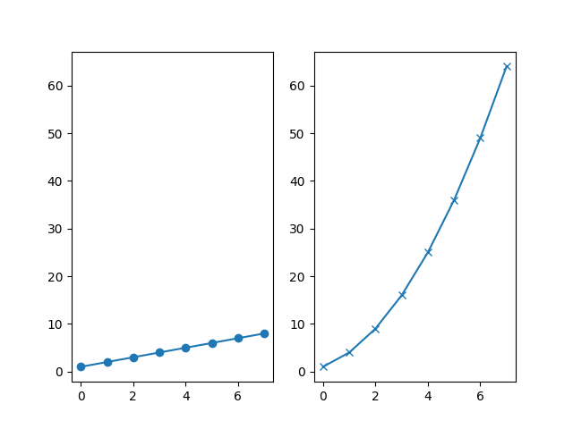
Subplots
import numpy as np import matplotlib.pyplot as plt linear_data = np.array([1,2,3,4,5,6,7,8]) exponential_data = linear_data**2 ax1 = plt.subplot(1,2,1) plt.plot(linear_data, '-o') ax2 = plt.subplot(1,2,2, sharey=ax1) plt.plot(exponential_data, '-x') plt.show()
Notes:
Lock axis between subplots to share x-axis, y-axis

Slide 31
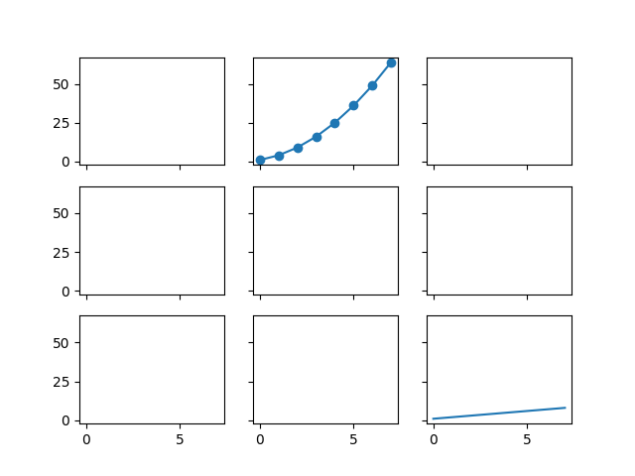
Subplots
import numpy as np import matplotlib.pyplot as plt linear_data = np.array([1,2,3,4,5,6,7,8]) exponential_data = linear_data**2 fig, ax = plt.subplots(3,3, sharex=True, sharey=True) ax[2,2].plot(linear_data, '-') ax[0,1].plot(exponential_data, '-o') plt.show()
Notes:
Get a matrix of plots by using function subplots

Slide 32
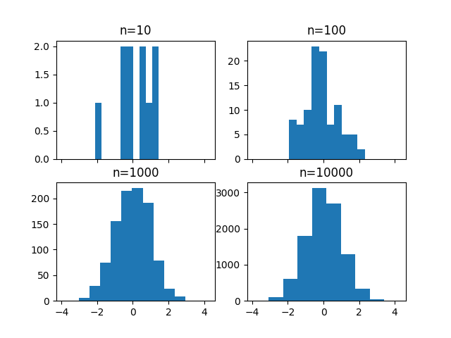
Histogram
import numpy as np import matplotlib.pyplot as plt fig, ((ax1, ax2), (ax3, ax4)) = plt.subplots(2,2, sharex=True) axs = [ax1, ax2, ax3, ax4] for n in range(0, len(axs)): sample_size = 10**(n+1) sample = np.random.normal(loc=0.0, scale=1.0, size=sample_size) axs[n].hist(sample) axs[n].set_title('n={}'.format(sample_size)) plt.show()
Notes:
We plot here 4 histogram based on the number of samples, the first just has 10 sample, the second has 100 and so on. We can find that the histogram is more and more smooth. But if you look closely, we can see that the bar of the 10000 plots are actually wider than those of the 10, 100, 1000. That’s because the histogram uses ten bins by default, that means ten bars. When n = 10000, many values have to be combined into a single bin.

Slide 33
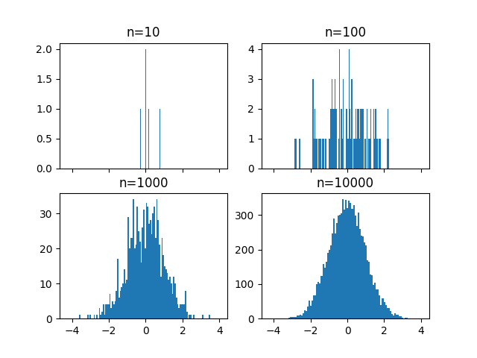
Histogram
import numpy as np import matplotlib.pyplot as plt fig, ((ax1, ax2), (ax3, ax4)) = plt.subplots(2,2, sharex=True) axs = [ax1, ax2, ax3, ax4] for n in range(0, len(axs)): sample_size = 10**(n+1) sample = np.random.normal(loc=0.0, scale=1.0, size=sample_size) axs[n].hist(sample, bins=100) axs[n].set_title('n={}'.format(sample_size)) plt.show()
Notes:
The histograms are more smooth when the number of bins is set to 100. Big question: how many bins should we set? That depends on the experiments and data

Slide 34
Histogram
import numpy as np import matplotlib.pyplot as plt fig, ((ax1, ax2), (ax3, ax4)) = plt.subplots(2,2, sharex=True) axs = [ax1, ax2, ax3, ax4] for n in range(0, len(axs)): sample_size = 10**(n+1) sample = np.random.normal(loc=0.0, scale=1.0, size=sample_size) axs[n].hist(sample, bins=100) axs[n].set_title('n={}'.format(sample_size)) plt.show()
Notes:
The histograms are more smooth when the number of bins is set to 100. Big question: how many bins should we set? That depends on the experiments and data

Slide 35
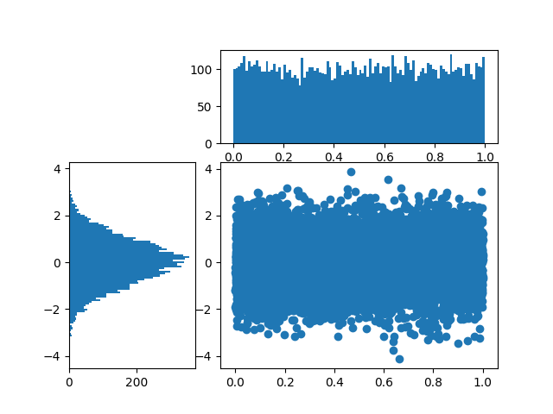
Histogram and Scatter Plot
import numpy as np import matplotlib.pyplot as plt import matplotlib.gridspec as gridspec gspec = gridspec.GridSpec(3, 3) top_histogram = plt.subplot(gspec[0, 1:]) side_histogram = plt.subplot(gspec[1:, 0]) lower_right = plt.subplot(gspec[1:, 1:]) Y = np.random.normal(loc=0.0, scale=1.0, size=10000) X = np.random.random(size=10000) lower_right.scatter(X, Y) top_histogram.hist(X, bins=100) side_histogram.hist(Y, bins=100, orientation='horizontal')
plt.show()
Notes:
Sometime we may need both, scatter plot and histogram when the scatter plot do not show the clustering, so we need see the distribution on each axis using histogram.
In this example, we plot scatter with X represent the random distribution and Y represents the normal distribution then using two histogram corresponding to each axis.
We use GridSpec to customize the location of plots/
We define a 3x3 grid, nine cells in total: the first histogram takes up the top right space, the second take up the left bottom two spaces and the scatter plot take up two spares in the bottom right.

Slide 36
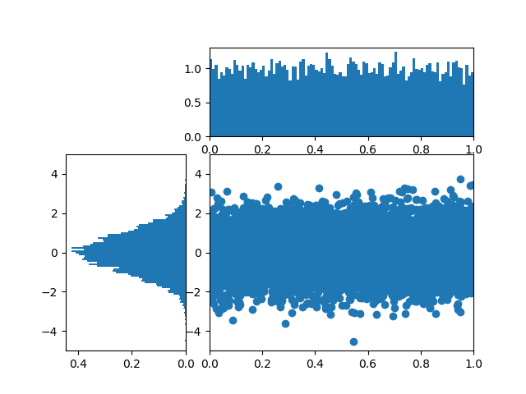
Histogram and Scatter Plot
import numpy as np import matplotlib.pyplot as plt import matplotlib.gridspec as gridspec gspec = gridspec.GridSpec(3, 3) top_histogram = plt.subplot(gspec[0, 1:]) side_histogram = plt.subplot(gspec[1:, 0]) lower_right = plt.subplot(gspec[1:, 1:]) Y = np.random.normal(loc=0.0, scale=1.0, size=10000) X = np.random.random(size=10000) lower_right.scatter(X, Y) top_histogram.hist(X, bins=100, normed=True) side_histogram.hist(Y, bins=100, orientation='horizontal', normed=True) # flip the side histogram's x axis side_histogram.invert_xaxis() for ax in [top_histogram, lower_right]: ax.set_xlim(0, 1) for ax in [side_histogram, lower_right]: ax.set_ylim(-5, 5)
plt.show()
Notes:
We need rotating the side_histogram and may set limitation for two axis X and Y so they are nicer

Slide 37
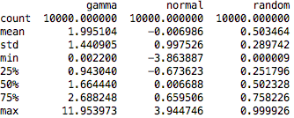
Box Plots
import numpy as np import matplotlib.pyplot as plt import pandas as pd normal_sample = np.random.normal(loc=0.0, scale=1.0, size=10000) random_sample = np.random.random(size=10000) gamma_sample = np.random.gamma(2, size=10000) df = pd.DataFrame({'normal': normal_sample, 'random': random_sample, 'gamma': gamma_sample}) df.describe()
Notes:
Box plot la mot phuong phap the hien so lieu thong ke tong hop cua cac mau khac nhau mot cach suc tich
Moi hop hien thi cho moi mau: gia tri trung binh, muc toi thieu, muc toi da va dai phan doan du lieu
Gia su chung ta muon hien thi 3 mau cho phan phoi chuan, phan phoi ngau nhien va phan phoi Gamma, sau do bieu dien du lieu voi DataFrame cua module Pandas.
Pandas la mot cong cu manh me cua Python de xu ly cac time series va phan tich du lieu.

Slide 38
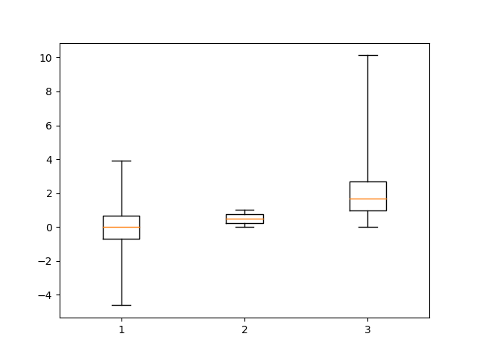
Box Plots (cont.)
import numpy as np import matplotlib.pyplot as plt import pandas as pd normal_sample = np.random.normal(loc=0.0, scale=1.0, size=10000) random_sample = np.random.random(size=10000) gamma_sample = np.random.gamma(2, size=10000) df = pd.DataFrame({'normal': normal_sample, 'random': random_sample, 'gamma': gamma_sample}) plt.boxplot([ df['normal'], df['random'], df['gamma'] ], whis='range') plt.show()
Notes:
Box plot la mot phuong phap the hien so lieu thong ke tong hop cua cac mau khac nhau mot cach suc tich
Moi hop hien thi cho moi mau: gia tri trung binh, muc toi thieu, muc toi da va dai phan doan du lieu
Gia su chung ta muon hien thi 3 mau cho phan phoi chuan, phan phoi ngau nhien va phan phoi Gamma, sau do bieu dien du lieu voi DataFrame cua module Pandas.
Pandas la mot cong cu manh me cua Python de xu ly cac time series va phan tich du lieu.
Doi voi moi mau du lieu, cac gia tri lon nhat, nho nhat va 3 gia tri % cho 25, 50, 75 duoc tinh toan va hien thi, cac gia tri phan tram nay cho chung ta biet ve dai phan doan du lieu q1, q2, q3
Chung ta se dung box plot de hien thi cac gia tri nay

Slide 39
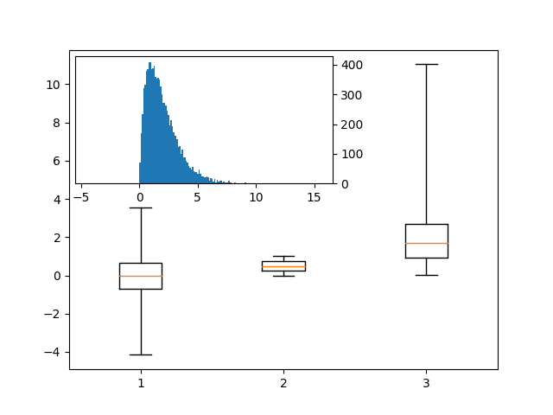
Box Plots (cont.)
import numpy as np import matplotlib.pyplot as plt import pandas as pd normal_sample = np.random.normal(loc=0.0, scale=1.0, size=10000) random_sample = np.random.random(size=10000) gamma_sample = np.random.gamma(2, size=10000) df = pd.DataFrame({'normal': normal_sample, 'random': random_sample, 'gamma': gamma_sample}) import mpl_toolkits.axes_grid1.inset_locator as mpl_il plt.boxplot([ df['normal'], df['random'], df['gamma'] ], whis='range') ax2 = mpl_il.inset_axes(plt.gca(), width='60%', height='40%', loc=2) ax2.hist(df['gamma'], bins=100) ax2.margins(x=0.5) ax2.yaxis.tick_right() plt.show()
Notes:
Quan sát thấy đối với phân phối gamma, các giá trị sample khá lệch nhau, chúng ta sẽ show histogram của mẫu này.
Đối với 1 subplot, chúng ta luôn luôn có tương ứng 1 đối tượng Axes. Vậy làm thế nào để tích hợp 1 subplot khác bên trong 1 subplot.
Chúng ta sẽ sử dụng một số gói toolkit của Matplot để làm việc này.
Cụ thể là mpl_toolkits.axes_grid1.inset_locator
Chúng ta sẽ gọi inset locator và đặt nó lên trên axes của current plot và xác định size cho axis mới thông qua định nghĩa width và height theo % của parent axis, vị trí của locator (lưu ý là đánh số thứ tự từ phải sang trái và từ trên xuống dưới)
Vì axis y bị chồng đè lên parent axis nên chúng ta sẽ đảo vị trí của axis y sang phải.

Slide 40
Using Pandas and Seaborn
Pandas is a powerful module allowing to fast and easily plot time-series and data-frames
Pandas uses matplotlib under the hood and provides some convenient functions for visualizing data
Seaborn is a Python visualization library based on matplotlib
Seaborn makes creation of specific types of complicated plots much simpler

Slide 41
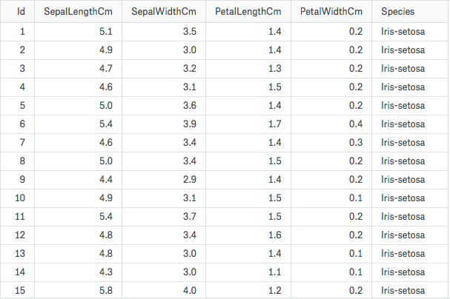
Practice with Pandas and Seaborn
import pandas as pd import seaborn as sns import matplotlib.pyplot as plt iris = pd.read_csv("../input/Iris.csv")
iris.head()
Notes:
We will use iris dataset for this example

Slide 42
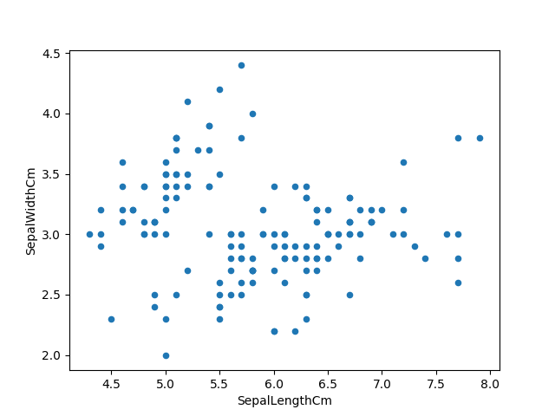
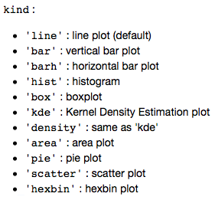
Practice with Pandas and Seaborn
import pandas as pd import seaborn as sns import matplotlib.pyplot as plt iris = pd.read_csv("../input/Iris.csv") iris.head() iris["Species"].value_counts() iris.plot(kind="scatter", x="SepalLengthCm", y="SepalWidthCm") plt.show()
Notes:
Su dung ham .plot tu Pandas dataframes

Slide 43
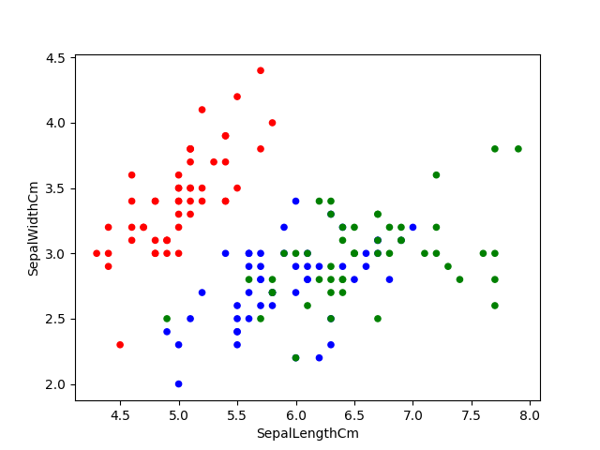
Practice with Pandas and Seaborn
import pandas as pd import seaborn as sns import matplotlib.pyplot as plt iris = pd.read_csv("../input/Iris.csv") iris.head() iris["Species"].value_counts() col = iris['Species'].map({"Iris-setosa":'r', "Iris-virginica":'g', "Iris-versicolor":'b'}) iris.plot(kind="scatter", x="SepalLengthCm", y="SepalWidthCm", c=col) plt.show()
Notes:
Colorize scatterplot with pandas

Slide 44
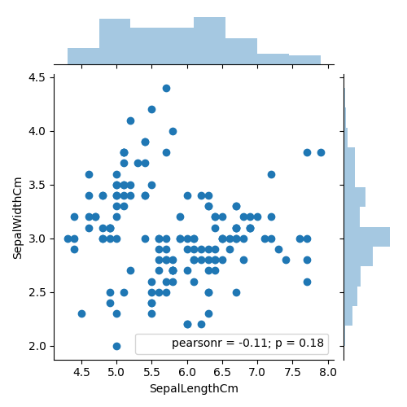
Practice with Pandas and Seaborn
import pandas as pd import seaborn as sns import matplotlib.pyplot as plt iris = pd.read_csv("../input/Iris.csv") iris.head() iris["Species"].value_counts() sns.jointplot(x="SepalLengthCm", y="SepalWidthCm", data=iris, size=5) plt.show()
Notes:
Su dung ham jointplot cua seaborn cho phep sinh scatter plot tuong tu nhung ket hop them 2 histogram cho tung variable.

Slide 45
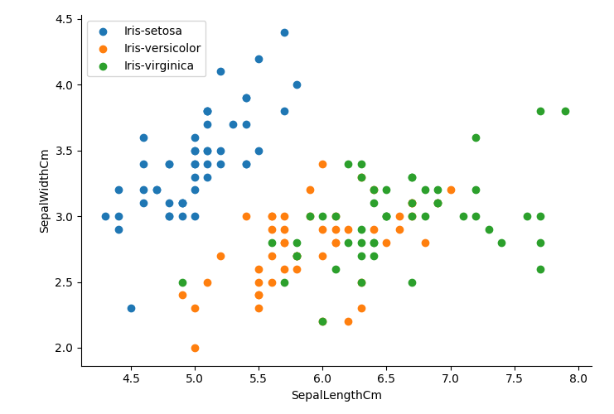
Practice with Pandas and Seaborn
import pandas as pd import seaborn as sns import matplotlib.pyplot as plt iris = pd.read_csv("../input/Iris.csv") iris.head() sns.FacetGrid(iris, hue="Species", size=5) .map(plt.scatter, "SepalLengthCm", "SepalWidthCm")
plt.legend(loc='upper left') plt.show()
Notes:
Customize the color of scatterplot by species, using FacetGrid of Seaborn

Slide 46
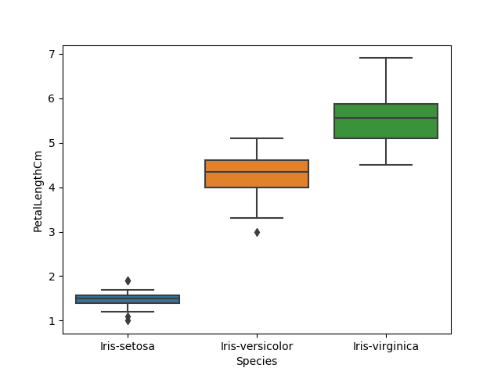
Boxplot
import pandas as pd import seaborn as sns import matplotlib.pyplot as plt iris = pd.read_csv("../input/Iris.csv") iris.head() sns.boxplot(x="Species", y="PetalLengthCm", data=iris) plt.show()
Notes:
Boxplot with seaborn

Slide 47

Seaborn.boxplot
import pandas as pd import seaborn as sns import matplotlib.pyplot as plt iris = pd.read_csv("../input/Iris.csv") iris.head() ax = sns.boxplot(x="Species", y="PetalLengthCm", data=iris) ax = sns.stripplot(x="Species", y="PetalLengthCm", data=iris, jitter=True, edgecolor="gray")
plt.show()
Notes:
Su phan bo cua cac points doi voi tung hop de thay duoc dai phan bo du lieu :
Đối với setosa, dữ liệu tập trung ở trung vị
Đối với versicolor: dữ liệu phân bổ dọc, có 1 điểm dữ liệu nằm ngoài hẳn dải phân bổ dữ liệu
Đối với virginica: tương tự dữ liệu phân bổ dọc theo hộp

Slide 48
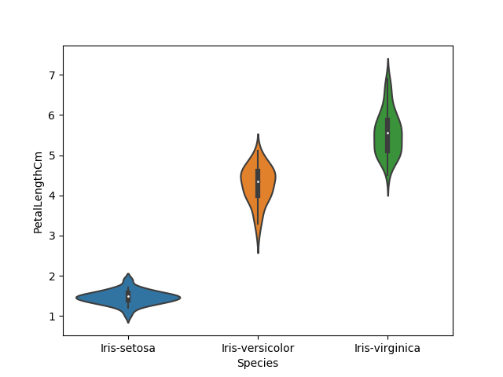
Seaborn.violinplot
import pandas as pd import seaborn as sns import matplotlib.pyplot as plt iris = pd.read_csv("../input/Iris.csv") iris.head() sns.violinplot(x="Species", y="PetalLengthCm", data=iris, size=6)
plt.show()
Notes:
Sử dụng Violinplot sẽ kết hợp tác dụng của cả hai plots ở phần trước
Các vùng dày đặc dữ liệu sẽ tương ứng với khu vực khuỳnh to của violinplot

Slide 49
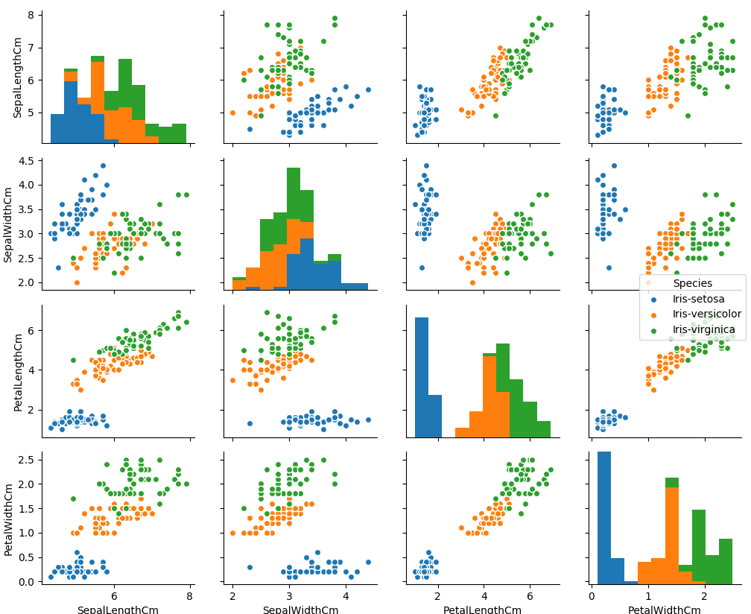
Seaborn.pairplot
import pandas as pd import seaborn as sns import matplotlib.pyplot as plt iris = pd.read_csv("../input/Iris.csv") iris.head() sns.pairplot(iris.drop("Id", axis=1), hue="Species", size=3) plt.show()
Notes:
Một hàm plot khác của seaborn khá hữu ích và hay được sử dụng là hàm pairplot, cho biết mối quan hệ tương quan giữa từng cặp thuộc tính (column) của dataset
Từ các subplot nay, chung ta co the thay rang Iris setosa tách biệt hoàn toàn khỏi 2 sample còn lại, theo từng cặp thuộc tính

Slide 50
Graphs
edge
node

Slide 51
Graphs
edge
node
If we add this edge then this would be a complete graph, also called a clique

Slide 52
Directed Graphs and Hierarchies
Directed vs Undirected
Cyclic vs acyclic
Tree
Minimally connected
N nodes, n-1 edges
Single parent node can have multiple child nodes
Hierarchy
Acyclic directed graph
Having a root node

Slide 53
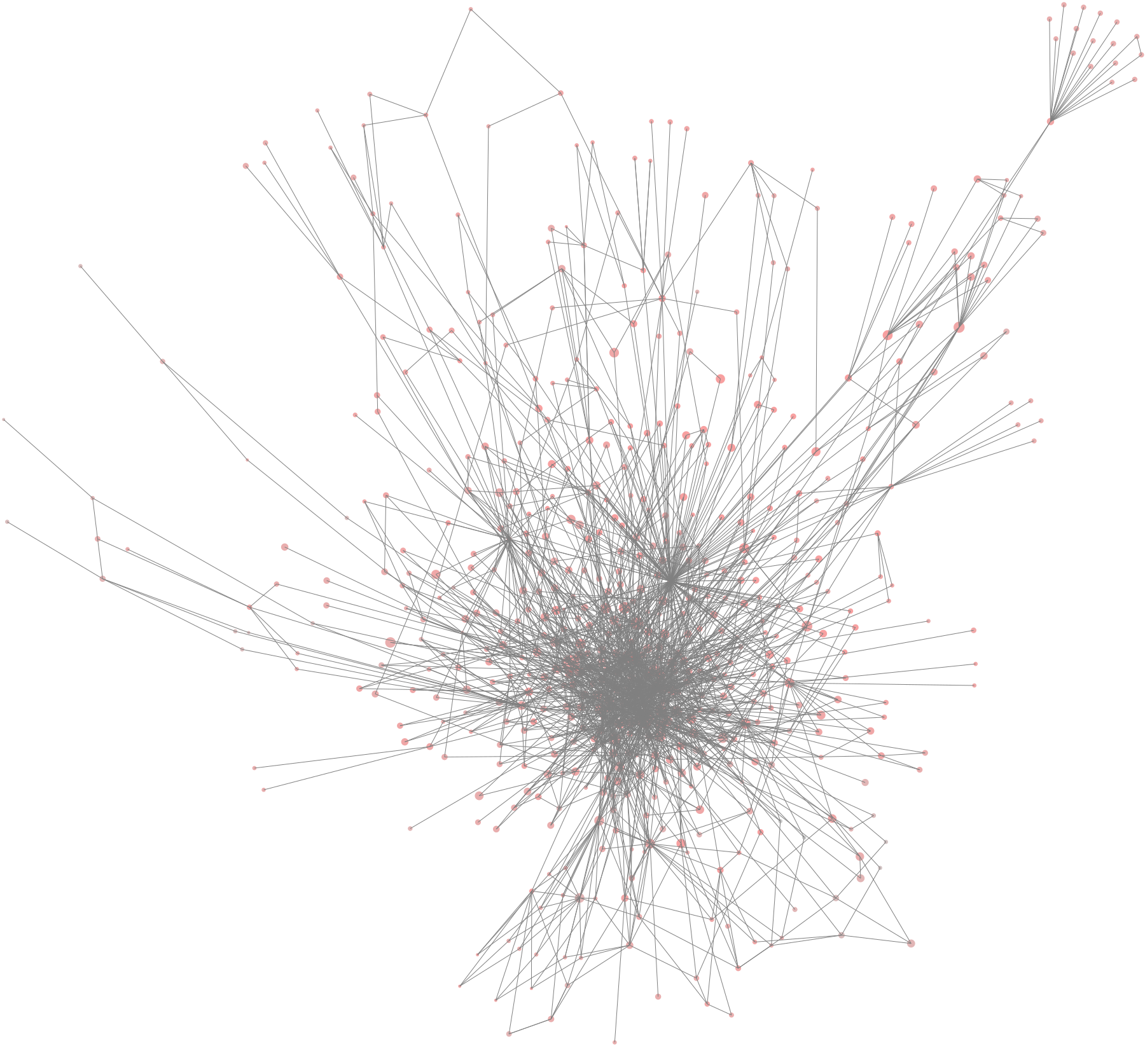
Node Degree
Degree of a node = number of edges
Directed graph nodes have an in-degree and an out-degree
Social Networks
Many low degree nodes and fewer high degree nodes
Also called power-law or scale-free graphs

Slide 54
Graph Visualization
For visualizing more abstract and non-quantitative data
For example:
The relationship/contacts of individuals in a population (also called network of contacts)
The hierarchical structure of classes in a module
Matplotlib does not support this kind of visualization

Slide 55
Roassal: an agile visualization tool
Roassal is a DSL, written in Smalltalk and integrated in Pharo/Moose – an open source platform for software and data analysis
Installing from: http://www.moosetechnology.org

Slide 56
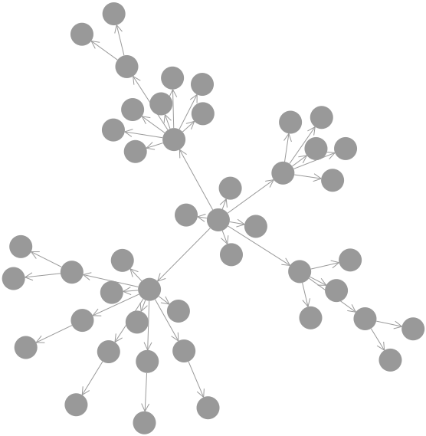
Hierarchy
| b |
b := RTMondrian new.
b shape circle size: 30.
b nodes: RTShape withAllSubclasses.
b shape arrowedLine withShorterDistanceAttachPoint.
b edgesFrom: #superclass.
b layout forceWithCharge: -500.
b build.
^ b view
Notes:
The hierarchical structure of the class RTShape and all its subclasses

Slide 57
Network structure
| b lb |
b := RTMondrian new.
b shape circle color: (Color red alpha: 0.4).
b nodes: Collection withAllSubclasses.
b edges connectFrom: #superclass.
b shape
bezierLineFollowing: #superclass;
color: (Color blue alpha: 0.1).
b edges
notUseInLayout;
connectToAll: #dependentClasses.
b normalizer normalizeSize: #numberOfMethods min: 5 max: 50.
b layout force.
b build.
lb := RTLegendBuilder new.
lb view: b view.
lb addText: 'Circle = classes, size = number of methods; gray links = inheritance;'.
lb addText: 'blue links = dependencies; layout = force based layout on the inheritance links'.
lb build.
^ b view @ RTZoomableView

Slide 58
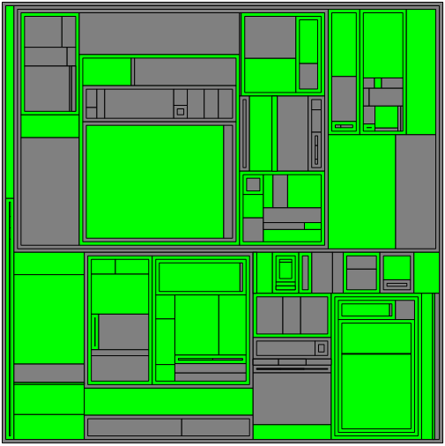
Tree Map
Maps quantities to area
Color used to differentiate areas
Shading delineates hierarchical regions
When to use?
Limited space but large amount of hierarchical data
Values can be aggregated in the tree structure
Advantages
Saving space, display a large number of item simultaneously
Using color and size of areas to detect special sample data
Notes:
Treemaps được sử dụng để hiển thị dữ liệu phân cấp
Chúng ta thường sử dụng treemaps khi không gian bị hạn chế và chúng ta có một số lượng lớn các dữ liệu phân cấp và cần có cái nhìn tổng quát về dữ liệu
Treemaps nên được sử dụng chủ yếu với các giá trị có thể tổng hợp được
Ưu điểm của treemaps:
Treemaps tiết kiệm được không gian biểu diễn và có thể hiển thị cùng lúc nhiều mục dữ liệu
Khi có mối tương quan giữa màu sắc và kích thước trong cấu trúc cây thì treemap giúp chúng ta dễ dàng phát hiện được các mẫu khác nhau căn cứ vào màu sắc và kích thước areas.

Slide 59
Tree map layout
1
2
1
1
1
2
2
1
1
1
1
1
1

Slide 60
Tree map layout
16
11
5
4
4
3
3
2
1
2
1
1
1
2
2
1
1
1
1
1
1
Set parents node values to sum of child node values from bottom up
Notes:
Đặt giá trị các parent node thành tổng các giá trị của node con từ dưới lên

Slide 61
Tree map layout
16
11
5
4
4
3
3
2
1
2
1
1
1
2
2
1
1
1
1
1
1
11/16
5/16
Set parents node values to sum of child node values from bottom up
Partition based on current node’s value as a portion of parent node’s value from top down
Notes:
Việc phân vùng trên treemap dựa trên giá trị của node hiện tại bằng cách chia vùng từ giá trị của node parent từ trên xuống dưới

Slide 62
Tree map layout
16
4/11
3/5
11
5
4
4
3
3
2
4/11
1
2
1
1
1
2
2
1
1
1
1
1
1
11/16
5/16
2/5
Set parents node values to sum of child node values from bottom up
Partition based on current node’s value as a portion of parent node’s value from top down
3/11
Notes:
Việc phân vùng trên treemap dựa trên giá trị của node hiện tại bằng cách chia vùng từ giá trị của node parent từ trên xuống dưới

Slide 63
Tree map layout
16
2/4
1/3
1/4
3/5
4/11
1/4
11
5
1/3
4
4
3
3
2
1/4
1/4
2/4
4/11
1/3
1
2
1
1
1
2
2
1
1
1
1
1
1
11/16
5/16
2/5
Set parents node values to sum of child node values from bottom up
Partition based on current node’s value as a portion of parent node’s value from top down
1/3
2/3
3/11
1/3
1/3
Notes:
Việc phân vùng trên treemap dựa trên giá trị của node hiện tại bằng cách chia vùng từ giá trị của node parent từ trên xuống dưới

Slide 64
Project: Becoming an independent data scientist
You will be given a data-set
Each one state a research question about the data
Visualizing the data and justifying how your visualization addresses your stated research question

Slide 65
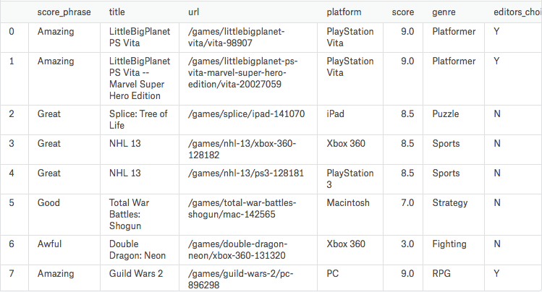
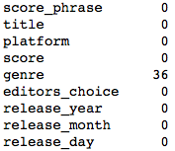
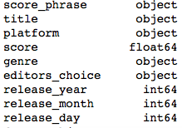
Games Dataset Analysis
import pandas as pd import seaborn as sns import matplotlib.pyplot as plt games= pd.read_csv("../input/ign.csv") games.head()
Using Pandas to view the dataset
Using some useful functions to check the dataset
#dropping the unneeded values
games.drop([’Unnamed: 0’, ’url’], axis=1, inplace=True)
games.isnull().sum()
games.dtypes

Slide 66
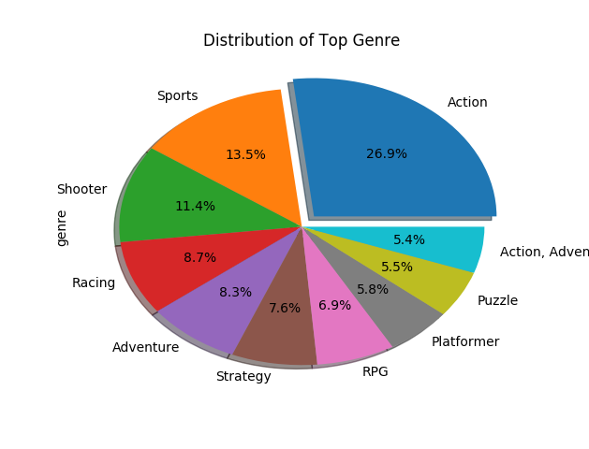
Stating research questions
Examples:
How is the genre of games distributed?
Visualizing data to answer to the question:
Using pie-chart to display the distribution of top genre’s
games['genre'].value_counts()[:10].plot(kind='pie',autopct='%1.1f%%',shadow=True,explode=[0.1,0,0,0,0,0,0,0,0,0]) plt.title('Distribution of Top Genre') plt.show()

Slide 67
Example research questions
Check the highest release in months and years
Check the score distribution
Check the top platforms for games
How are the releases by top genres by years
Platforms with highest releases by year
Top platforms with their favorite genres
…

Slide 68
Policy
Group of 3
Use given dataset and visualization charts to answer the choosen question
Send results to teacher: anhbtm@soict.hust.edu.vn including:
Code python
Report in .pdf format named as [Member1]-[Member2]-[Member3]-DataViz.pdf
Report should present the problem and the solution to address this problem
Deadline: Before 0h 6/11/2019

